Slide 1







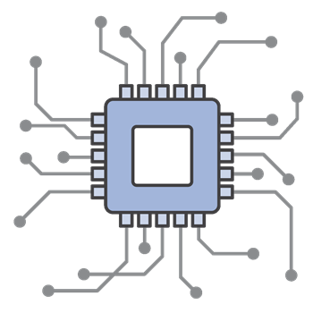








TEMPERATURE
SENSOR
HUMIDITY
SENSOR
IOT-WATSON
PLATFORM
USERS
WEB UI
GPS-WEATHER
IOT -DEVICE
FAST2SMS
MIT-APP
WIFI-GSM
MODULE
BOARDS
(API KEYS)
SOIL MOISTURE
SENSOR
WATER PUMP MOTOR
CLOUDANT DB

